Slide 1
Data Analysis Results of Rockbuster Stealth Movie Rental Service
Presented by: Comfort Omotuyole
September 2023

Slide 2
OBJECTIVE
To help with the development of strategies for launching Rockbuster Stealth‘s new online video service in order to stay competitive.

Slide 3

BUSINESS QUESTIONS
Which movies contributed the most/least to revenue gain?
What was the average rental duration for all videos?
Which countries are Rockbuster customers based in?
Where are customers with a high lifetime value based?
Do sales figures vary between geographic regions?

Slide 4
Descriptive Statistics for 1000 Movies released in 2006
 | Rental Rate | Length | Replacement Cost | Rental Duration
Minimum | 0.99 | 46 | 9.99 | 3
Maximum | 4.99 | 185 | 29.99 | 7
Average | 2.98 | 115.272 | 19.984 | 4.985

Slide 5
Descriptive Statistics (cont‘d)
17 movies, with maximum rental rate of 4.99 and minimum replacement cost of 9.99, contributed the most to revenue gain(*)
22 movies, with minimum rental rate of 0.99 and maximum replacement cost of 29.99, contributed the least to revenue gain(*)
The average rental duration for all videos was 4.985
*Names of the movies are included in the Appendix.

Slide 6
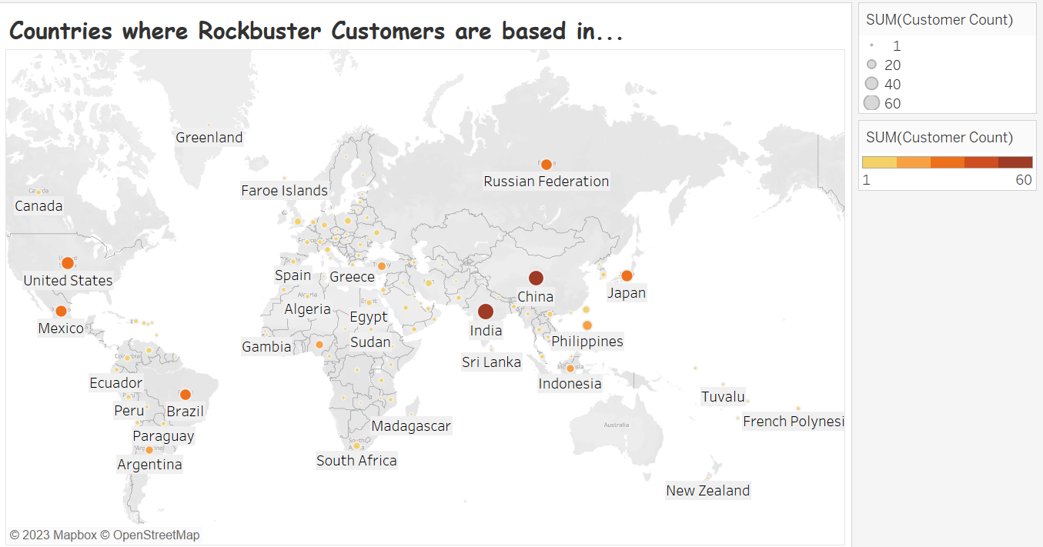

Slide 7
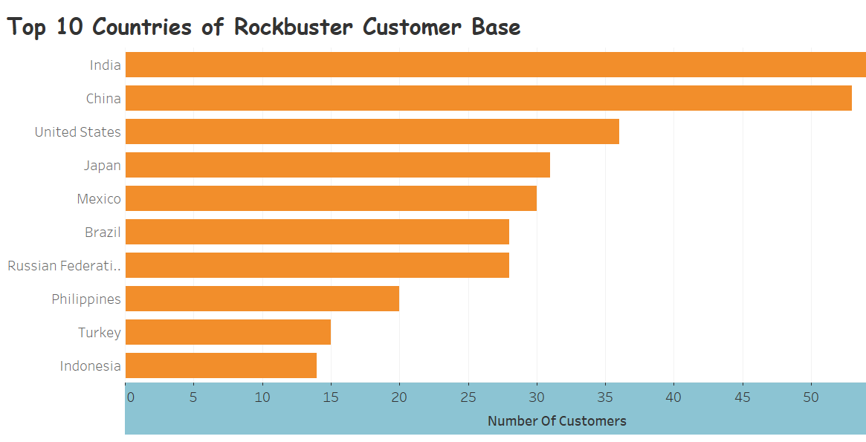

Slide 8
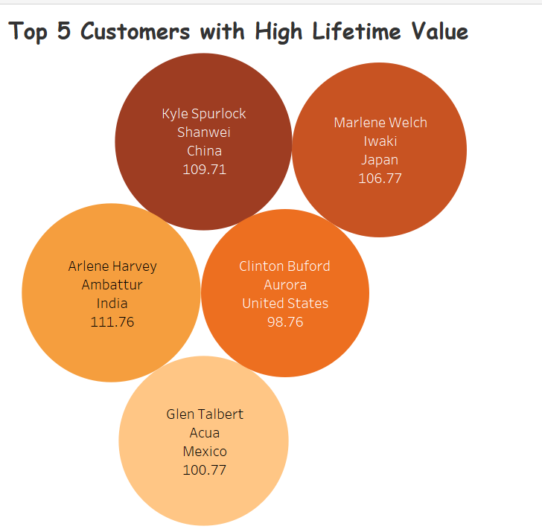

Slide 9
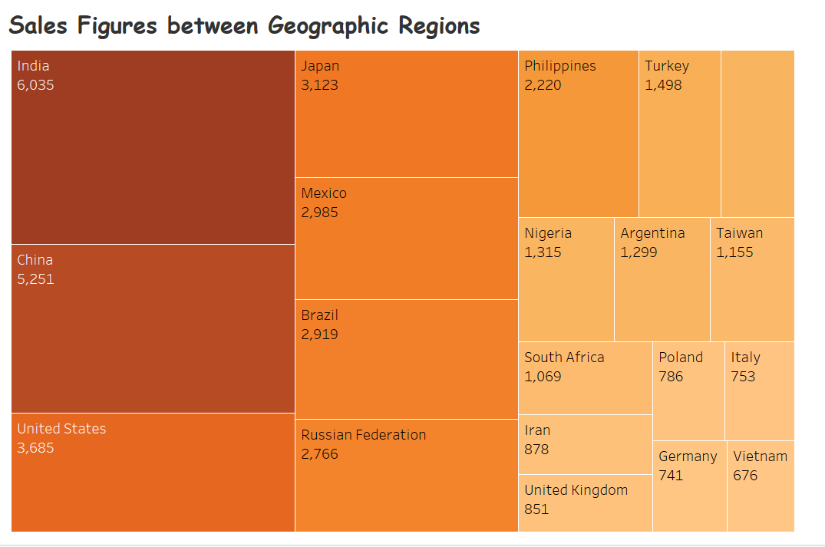

Slide 10
Recommendations…
Introduction of the new online video service should begin with the countries with highest customer base.
The online versions of the movies which have contributed the most to the company‘s revenue gain should be introduced first and spread across the geographic regions of the world.
Research on reasons why high lifetime customers choose company‘s movies, and apply reasons to geographic areas of low sales

Slide 11
Appendix
Title | Category
Control Anthem | Comedy
Daisy Menagerie | Sci-Fi
Dude Blindness | Sports
Edge Kissing | Drama
Fellowship Autumn | Travel
Heartbreakers Bright | Children
Kissing Dolls | Action
Maiden Home | New
Matrix Snowman | Foreign
North Tequila | Documentary
Opposite Necklace | Family
Paths Control | Drama
Pluto Oleander | New
Stepmom Dream | Foreign
Sting Personal | New
Thin Sagebrush | Documentary
Truman Crazy | Action
Movies which contributed the most to revenue gain:

Slide 12
Appendix
Title
Arabia Dogma
Ballroom Mockingbird
Bonnie Holocaust
Clockwork Paradise
Clyde Theory
Cruelty Unforgiven
Earth Vision
Everyone Craft
Feud Frogmen
Gilmore Boiled
Goldfinger Sensibility
Graffiti Love
Hills Neighbors
Hollywood Anonymous
Honey Ties
Japanese Run
Loathing Legally
Patient Sister
River Outlaw
Sassy Packer
Song Hedwig
Tracy Cider
Movies which contributed the least to revenue gain:

Slide 13
Appendix
DI Exercise 3.10 Task 1 | Tableau Public

